Slide 1

DOSETWIN AI: A DIGITAL TWIN FRAMEWORK FOR PERSONALIZED DRUG RESPONSE SIMULATION AND MEDICATION CONFLICT PREVENTION
SOA Project Review-2
Thursday, August 27th, 2026
 | Under the Guidance of Dr. Srikanth Cherukuvada Assistant Professor, Department of Computer Science and Engineering, KLH CSE Bowrampet Campus
Team Members P Ruthvik 2420030546 S.Akshay 2420030579 P.Nitish 2420030642

Slide 2
Outline of Research Work
Focus
Introduction
Literature Survey
Challenges
Research Objectives
Conclusion & Future Work
References
Publications Details

Slide 3
Problem Statement
Personalized drug response varies from patient to patient due to differences in health conditions, physiological observations, and medication combinations. Drug–drug interactions (DDIs) may lead to adverse effects, while patient information, medication data, interaction analysis, and drug-response prediction are often handled as separate components.
Existing research has explored Digital Twins, AI/ML-based drug-response prediction, Drug–Drug Interaction detection, Knowledge Graphs, and healthcare interoperability, but these capabilities are largely fragmented.
Therefore, there is a need for an integrated Service-Oriented Architecture (SOA) framework that can represent a patient as a Digital Twin, analyze medication interactions, simulate drug response, and provide the results through an interoperable application.

Slide 4
Objectives
To develop a patient-centric Digital Twin for representing patient health, medication, and clinical information.
To implement personalized drug-response simulation using AI/ML techniques based on patient-specific features.
To detect potential Drug–Drug Interactions (DDIs) using a Knowledge Graph-based approach.
To represent patient healthcare information using FHIR-based resources for improved interoperability.
To design an SOA-based architecture with modular services for patient, medication, interaction, FHIR, Knowledge Graph, and ML components.
To provide an interactive web dashboard that integrates patient analysis, medication conflicts, simulated response, and risk information.

Slide 5
Literature Survey
Authors | Title of the Paper | Methodology | Inferences | Limitation / Future Work
Vallée et al. [1] | Multi-scale Digital Twins for Personalized Medicine, Frontiers in Digital Health, 2026 | • Multi-scale Digital Twin modelling• Clinical, molecular and biological data integration• AI/ML-based modelling | • Supports individualized health simulation.• Helps model personalized treatment strategies.• Can integrate multiple patient data sources. | • Data integration remains challenging.• Requires stronger validation.• Privacy and ethical issues need attention.
Jarab et al. [2] | Digital Twins in Precision Pharmacotherapy: Emerging Applications, Challenges, and Future Directions, Frontiers in Digital Health, 2026 | • Patient Digital Twins• Pharmacokinetic/pharmacodynamic modelling• Medication and clinical data integration | • Supports individualized drug therapy.• Can simulate treatment response.• Useful for precision dosing and polypharmacy. | • Requires reliable patient data.• Clinical validation is still required.• Real-time integration remains difficult.
Mohan Babu & Madhan [3] | Human Digital Twins in Personalized and Predictive Healthcare: A Comprehensive Review of Technologies, Applications, and Future Directions, Frontiers in Digital Health, 2026 | • Human Digital Twin architecture• AI and computational modelling• Predictive healthcare analytics | • Supports personalized and predictive healthcare.• AI improves patient simulation.• Can support prediction of health and treatment outcomes. | • Data quality and privacy remain challenges.• Real-world clinical validation is limited.• Heterogeneous data integration needs further research.

Slide 6
Authors | Title of the Paper | Methodology | Inferences | Limitation / Future Work
Venkatapurapu et al. [4] | Digital Twins for Accelerating Drug Discovery and Development: Opportunities and Challenges, Drug Discovery Today, 2026 | • Digital Twin modelling• Quantitative pharmacological modelling• Machine learning | • DTs can support drug development.• Combines modelling with healthcare data.• ML can assist treatment-response simulation. | • Model reliability remains a concern.• Data integration is challenging.• Regulatory acceptance is required.
Tran & Klau [5] | Drug Response Prediction: A Critical Systematic Review of Current Datasets and Methods, Pattern Recognition Letters, 2026 | • Systematic review of drug-response datasets• ML prediction methods• Dataset evaluation | • Drug-response prediction supports personalized medicine.• ML is widely used for response prediction.• Dataset quality strongly affects performance. | • Dataset inconsistency affects reliability.• Generalization remains difficult.• Better real-world datasets are required.
Duan et al. [6] | Multi-Modal Contrastive Learning Based on Molecular and Textual Data for Drug Response Prediction, Neural Networks, 2026 | • Molecular representation learning• Textual drug information• Multi-modal contrastive learning | • Combining multiple data types improves drug representation.• Multi-modal AI can capture complementary information.• Supports personalized drug-response modelling. | • Requires high-quality datasets.• Model complexity increases.• Real-patient validation is needed.

Slide 7
Authors | Title of the Paper | Methodology | Inferences | Limitation / Future Work
Luo et al. [7] | Multi-relational Knowledge Graph for Drug-Drug Interaction Prediction via Dual Aggregation and Collaborative Optimization, Bioorganic Chemistry, 2026 | • Multi-relational Knowledge Graph• Graph representation learning• Drug–drug relationship modelling | • Knowledge Graphs represent complex drug relationships.• Graph learning can improve DDI prediction.• Multiple relationships provide richer interaction information. | • Large graphs increase computational complexity.• Rare drugs may have limited information.• Clinical validation is required.
[Authors] [8] | Knowledge-Enhanced Graph Transformer with Contrastive Learning for Drug-Drug Interaction Prediction, Machine Learning with Applications, 2026 | • Knowledge Graph embeddings• Graph Transformer• Contrastive learning | • Knowledge-enhanced graph models capture complex drug relationships.• Supports automated DDI prediction.• Can improve representation of drug interactions. | • Requires substantial training data.• Generalization to new drugs is challenging.• Higher computational complexity.
[Authors] [9] | A Knowledge Graph-Driven Framework for Deploying AI-Powered Patient Digital Twins, Future Generation Computer Systems, 2026 | • Knowledge Graph-driven Digital Twin• Modular AI framework• FHIR-compliant APIs | • Connects Knowledge Graphs with patient Digital Twins.• FHIR APIs support healthcare interoperability.• Modular architecture supports AI integration. | • Real-time clinical deployment requires validation.• Data integration remains complex.• Reliable clinical data streams are required.
Healthcare Digital Twin Review [10] | Healthcare Digital Twins: A Methodological Literature Review on Integrating IoT and AI for Personalized Medicine and Predictive Care, Telematics and Informatics Reports, 2026 | • Methodological literature review• Healthcare Digital Twin analysis• IoT + AI integration | • AI and IoT enable personalized Digital Twins.• Supports predictive healthcare.• Data-driven DTs can improve individualized modelling. | • Privacy and ethical concerns remain.• Security needs further attention.• Clinical implementation requires additional research.

Slide 8
Research Gap Identification
Existing Research / Approach | Research Gap Identified | Our Proposed Solution
1. Digital Patient Twins for Personalized Healthcare – Existing research uses Digital Twins to represent patients using physiological, clinical, and health data for personalized healthcare. | Current Digital Twin research often focuses on modelling and simulation, but reliable patient-specific drug-response simulation and medication-conflict analysis are not fully integrated into one executable system. | DoseTwin AI Digital Twin – Creates a patient-specific virtual representation combining patient data, observations, medications, and conditions for personalized drug-response simulation.
2. AI/ML-Based Drug Response Prediction – ML and deep-learning approaches are used to predict drug response using patient, molecular, or pharmacological features. | Many approaches focus mainly on prediction models, without integrating the predicted response with patient medication history, drug interactions, and other clinical relationships. | AI Drug Response Engine – Uses an ML model to generate a simulated drug-response category and score using patient-specific features as part of the complete analysis workflow.
3. Drug–Drug Interaction & Knowledge Graph Approaches – Existing DDI research uses rules, Knowledge Graphs, and graph-learning methods to identify relationships between drugs. | DDI analysis is often treated as a separate prediction task and is not connected with the patient's Digital Twin and simulated drug response in one workflow. | Interaction + Knowledge Graph Engine – Represents patient–drug–condition–observation relationships and detects medication conflicts within the patient-level Digital Twin workflow.

Slide 9
Existing Research / Approach | Research Gap Identified | Our Proposed Solution
4. FHIR-Based Healthcare Interoperability – FHIR provides standardized healthcare resources for exchanging patient, medication, condition, and observation information. | FHIR mainly addresses data representation and interoperability; it does not itself provide Digital Twin simulation, DDI analysis, or ML-based drug-response prediction. | FHIR Integration Layer – Converts the simulated patient information into FHIR-style resources and connects interoperability with the Digital Twin analysis workflow.
5. Service-Oriented / Modular Healthcare Systems – SOA and microservice approaches divide healthcare applications into independent, reusable services. | 5. Service-Oriented / Modular Healthcare Systems – SOA and microservice approaches divide healthcare applications into independent, reusable services. | 5. Service-Oriented / Modular Healthcare Systems – SOA and microservice approaches divide healthcare applications into independent, reusable services.

Slide 10
Novelty
Novelty 1: Integrated Patient-Level Digital Twin
§ Unlike approaches that focus mainly on Digital Twin modelling, DoseTwin AI connects patient data, physiological observations, conditions, and medication information into a single patient-level Digital Twin for drug-response simulation.
Novelty 2: Unified Drug Response & Medication Conflict Analysis
§ Integrates AI/ML-based drug-response simulation with Knowledge Graph-based medication relationship analysis, enabling the system to evaluate drug response and potential medication conflicts within the same workflow.
Novelty 3: End-to-End SOA Healthcare Framework
§ Combines Digital Twin, HL7 FHIR, TensorFlow, Knowledge Graphs, FastAPI, PostgreSQL, and Docker into an executable service-oriented framework, connecting data, analytics, interoperability, and visualization through modular services.

Slide 11
Tech Stack
Layer | Technology Stack
Core Framework | Digital Twin
Healthcare Data & Interoperability | HL7 FHIR
AI & Machine Learning | TensorFlow
Knowledge Representation | Knowledge Graphs
Backend / Microservices | FastAPI
Database | PostgreSQL
DevOps / Deployment | Docker

Slide 12
Innovation, Creativity, and Novelty
Innovation:
▪ Uses a patient Digital Twin to represent patient-specific health and medication information and simulate personalized drug responses.
Creativity:
▪ Combines AI/ML, Knowledge Graphs, and medication-interaction analysis to connect patient–drug–condition relationships and identify potential medication conflicts.
Novelty:
▪ Integrates Digital Twin, HL7 FHIR, TensorFlow, Knowledge Graphs, FastAPI, PostgreSQL, and Docker into an SOA-based microservices framework for personalized drug-response simulation and medication conflict prevention.

Slide 13
Feasibility
Technical Feasibility:
DoseTwin AI is technically feasible using Digital Twins, HL7 FHIR, TensorFlow, Knowledge Graphs, FastAPI, PostgreSQL, and Docker, enabling modular development and integration of the proposed SOA framework.
Operational Feasibility:
The implemented workflow supports patient data management, medication analysis, drug-response simulation, and medication conflict detection through an integrated web application.
Economic Feasibility:
The system can be developed and deployed using open-source technologies and frameworks, minimizing software licensing and infrastructure costs.
Scalability:
The SOA-based microservices architecture allows individual services such as patient management, interaction analysis, ML prediction, FHIR processing, and Knowledge Graph services to be developed, deployed, and scaled independently.

Slide 14
Project Plan
Phase | Activity | Current Status / Output
Phase 1 | Literature Survey & Requirement Analysis | Completed – Literature reviewed and research gaps identified
Phase 2 | Digital Twin & SOA Architecture | Completed – Patient Digital Twin and modular SOA architecture implemented
Phase 3 | Healthcare Data & FHIR Integration | Completed – Patient, medication, condition and observation data integrated with HL7 FHIR
Phase 4 | AI/ML & Knowledge Graph Development | Completed – Drug-response prediction and medication conflict analysis implemented
Phase 5 | FastAPI & PostgreSQL Integration | Implemented – Backend services and structured database integration established
Phase 6 | Docker, Testing & Validation | Completed – Services tested and end-to-end workflow verified
Phase 7 | Documentation & Final Demonstration | In Progress – Review-2 presentation, documentation and project demonstration

Slide 15
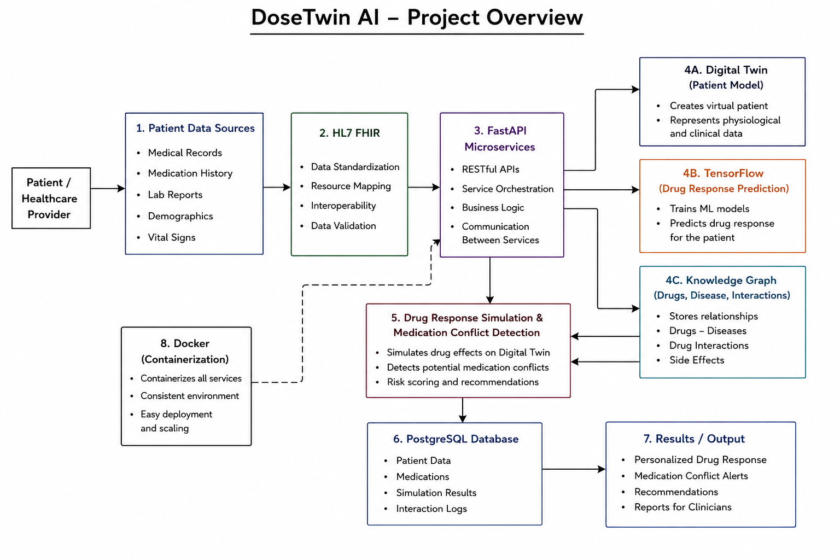
Project Architecture/Project Overview:

